Slide 1
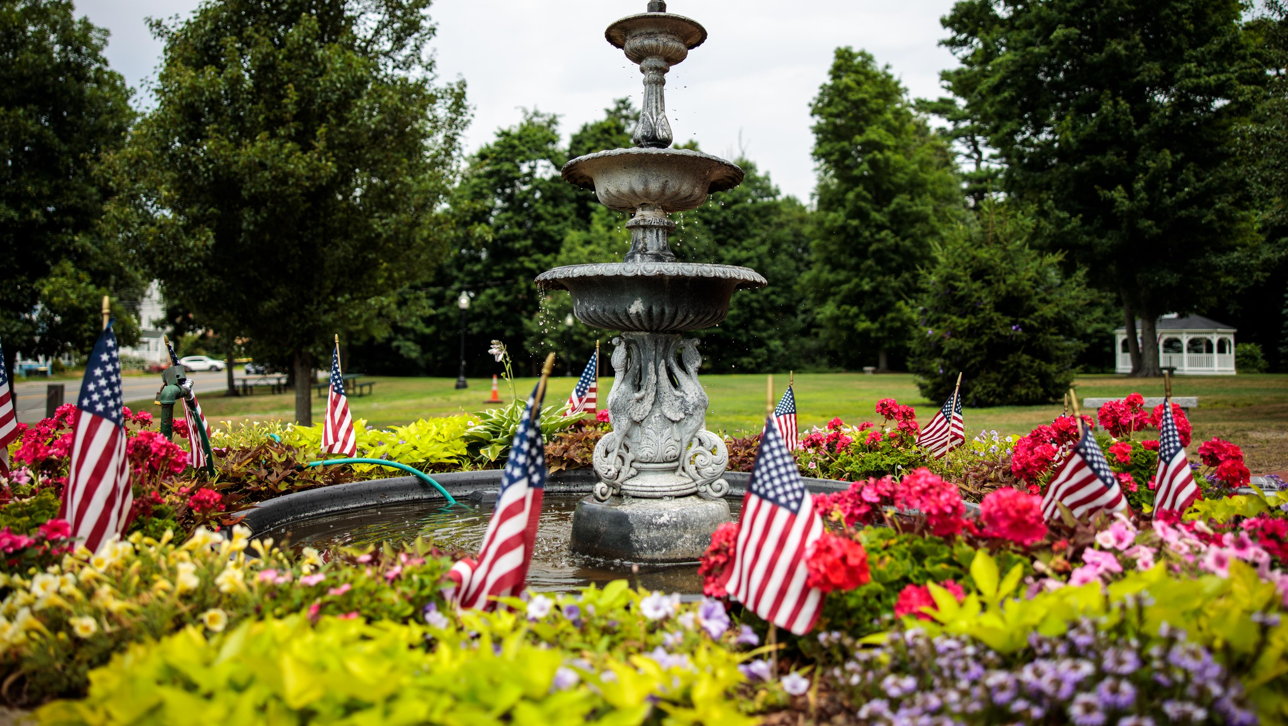
Demarco park Article 19

Slide 2
History
Former Lutheran Home for Children (1907 -1950)
Temporary Avon School during 1952-1954
Town purchased in 1997 for $654,500

Slide 3
History
Approximately 24 Acres
Dedicated in 2004
Summer Concert and Civic Association Events
Trail Project (approximate .3 miles), re-dedicated in 2013 after Eagle Scout Project

Slide 4
Capital Plan (Phase I)
Regrading and expansion of the parking area
Creation of a driveable path up to the pavilions from the parking area for event service and emergency access
Tree removals, regrading, and resurfacing to provide fully accessible walkways throughout the park as well as a loop for emergency access and/or event parking
Widening of existing entry points to allow two-way access at the main gate and a one way exit at the opposite end of the park for events
Removal and reinstallation of the "donor ring" at the fountain, including a retaining wall on the low side to bring the plaza into MAAB compliance
Relocation of the existing gazebo, benches, and picnic tables to facilitate accessibility
Installation of a new band pavilion to better serve the Town's summer concert series

Slide 5
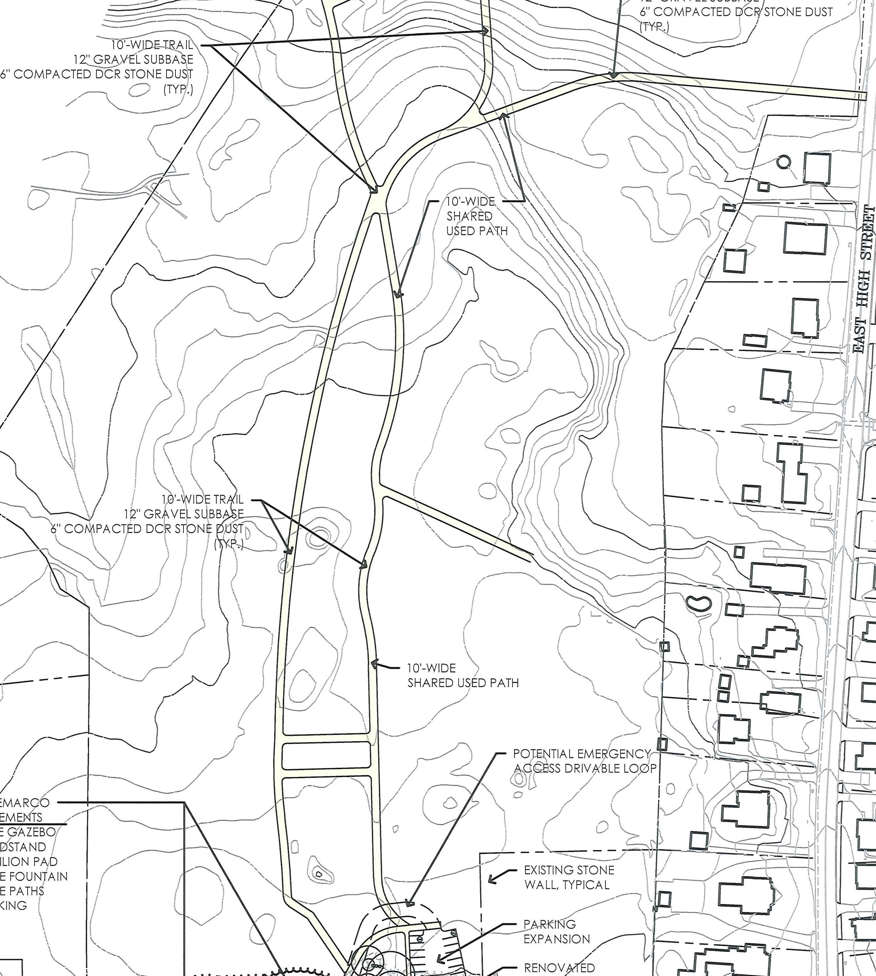
Capital Plan (Phase II)
Regrading and expansion of the trail system in the back and connecting to the current bike system on E. High Street.
10’FT wide trail system looping around.
Reconstructed Trails: 3,064 LF
New Trails: 970 LF

Slide 6
Design/Grants
OCPC did report in 2020 to review potential uses/needs
Town hired architect to review/design
Multi-generational/accessible design
Various public meetings on layout
If grants not successful, town ready to implement Phase I in a scaled down scope.

